Slide 1
The Dimensions of happiness
Authored by:
Jenn Brockman, Soumya murali, heather barker, Sebastian Munoz, and Chris Elliott

Slide 2
World Happiness report
The World Happiness Report is a landmark survey of the state of global happiness. was released at the United Nations at an event celebrating International Day of Happiness on March 20th. The report continues to gain global recognition as governments, organizations and civil society increasingly use happiness indicators to inform their policy-making decisions. Leading experts across fields – economics, psychology, survey analysis, national statistics, health, public policy and more – describe how measurements of well-being can be used effectively to assess the progress of nations. The reports review the state of happiness in the world today and show how the new science of happiness explains personal and national variations in happiness.
Our project – hap-py
Our project focused on why are countries happy? What types of things do they have in common, if anything?

Slide 3
HEATHER

Slide 4
Country Statistics - UNData
The United Nations Statistics Division (UNSD) of the Department of Economic and Social Affairs (DESA) launched a new internet based data service for the global user community. It brings UN statistical databases within easy reach of users through a single entry point (http://data.un.org/). This dataset contains key statistical indicators of the countries. It covers 4 major sections
General Information
Economic Indicators
Social Indicators
Environmental & Infrastructure Indicators

Slide 5
Urban Population does have an effect on the happiness of countries, the more urban areas a country has the happier the population seems.
Population using improved drinking water facilities makes countries happier.

Slide 6
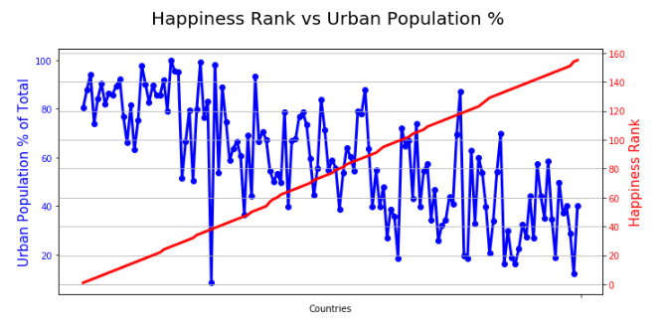
Urban populations tend to be happier
In the top 20 happiest countries the urban population is 83% of the total, while in the bottom 20 it only makes up 34%.

Slide 7
Urban populations outliers
Trinidad and Tobago, are the lower point on the Urban Population chart, they are the 38th happiest country with only 8.4% Urban Population

Slide 8
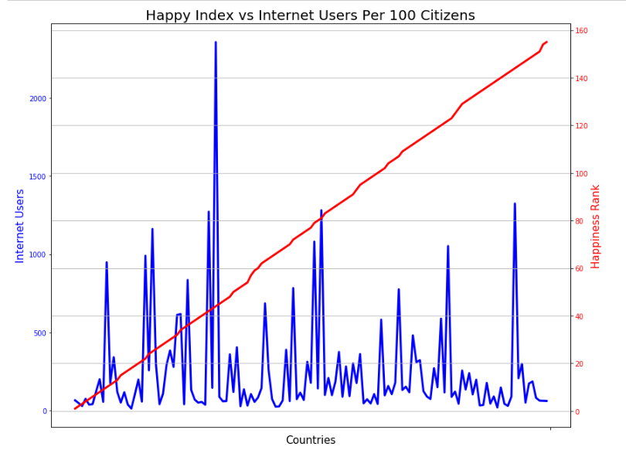

Slide 9
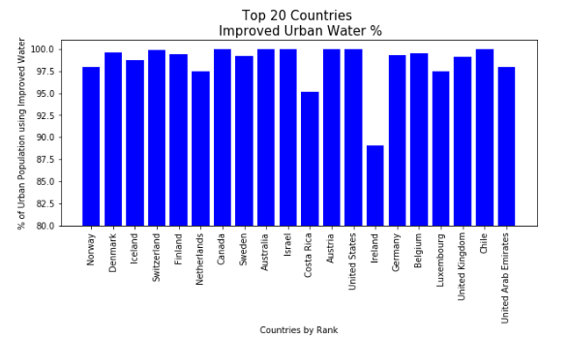
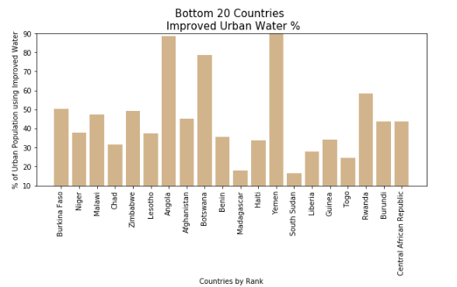
Countries with improved drinking water facilities tend to be happier
The top 20 happiest countries the population using improved drinking water facilities was an
% while the bottom 20 was only 44.7%

Slide 10
HEATHER reflection

